Slide 1
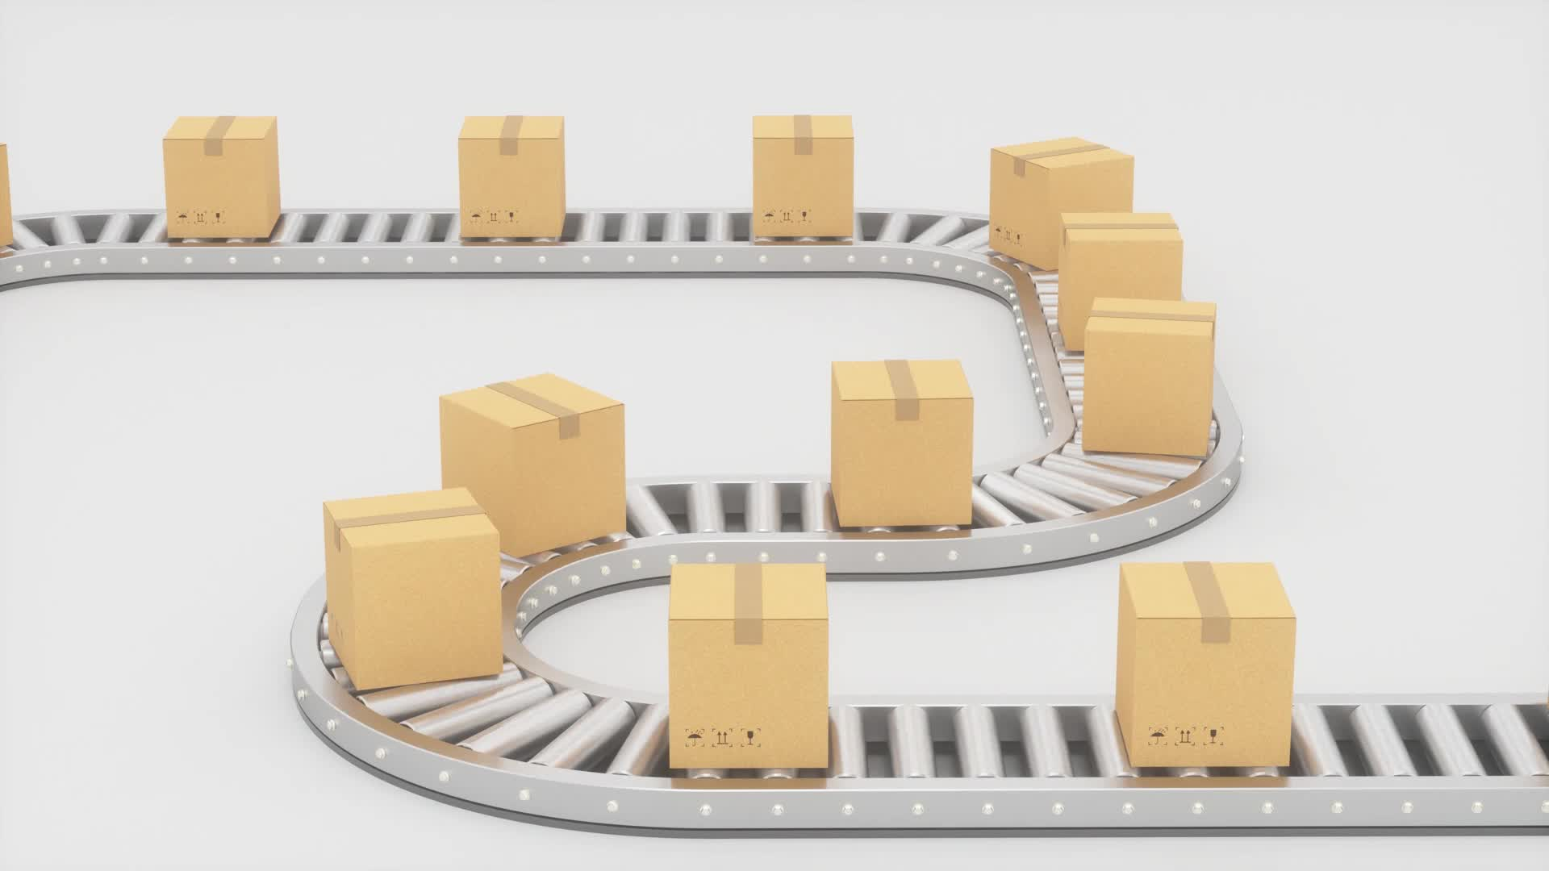
From Docker to kubernetes
All you need to deploy an application in kubernetes

Slide 2
Intro
• Easy to share;
• AutoScale;
• Orchestration;
• Routing;
• Same configuration on different Cloud providers;
• InfrastructureAsCode, ConfigurationAsCode.

Slide 3
Technologies
• Docker;
• Docker-compose;
• Terraform;
• Ansible;
• Jenkins;
• AWS.

Slide 4
Best practices Backend
• Read environment variables with default value;
• Use DB migrations;
• Publish logs in JSON format;
• HealthCheck endpoint;
• Stateless applications.

Slide 5
Best practices Frontend
• Use environments for build or launch;
• Use Paths for applications exposed locations;
• Build static applications.

Slide 6
Terraform
• All infrastructure configuration in terraform;
• Use remote state for team coworking;
• Exclude clear-text passwords.

Slide 7
Ansible
• Server configuration with ansible;
• Encrypted passwords;
• No manual changes.

Slide 8
Docker
• Dockerize an application;
• Optimization of Docker build process;
• Multistage Dockerfiles;
• Service configuration from Env variables.

Slide 9
Docker compose
• Local development with docker-compose;
• Test your application in docker;
• Expose local applications.

Slide 10
Kubernetes
• Simple steps to launch an application in kubernetes;
• Healthcheck, gracefull shutdown, migrations;
• Compatible configurations in different clouds.

Slide 11
Helm charts
• Create helm charts for developed applications;
• Application templates;
• Community helm charts;
• Set variable for Dev/Stage/Prod.

Slide 12
Pipelines
• Create simple pipelines for build or deploy applications;
• All build operations from command line;
• Notifications for fails;
• Automated tests scenarios;
• Artefactory storage.

Slide 13
CD in multiple environments
• Pipelines for continuous deployment in multiple environments;
• Different deploy scripts per environment.

Slide 14
Monitoring
• Log Monitoring;
• Application metrics;
• Alerting;
• Automatic fixes;
• Internal/External monitoring.

